Slide 1
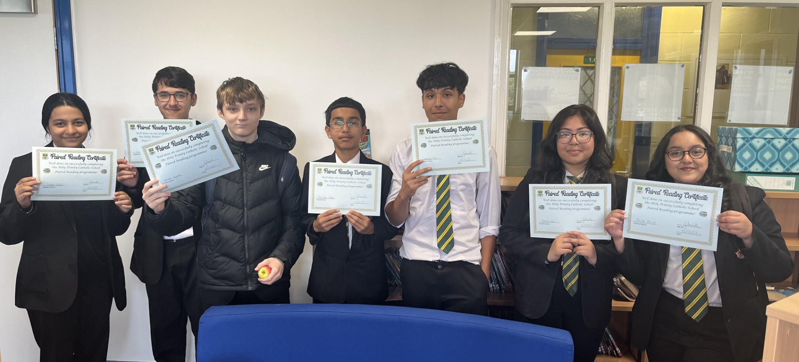
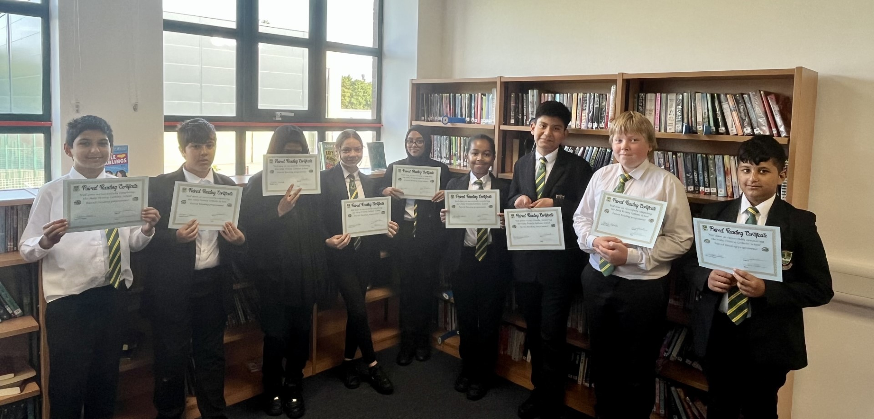
Well Done
to the following students for completing the Holy Trinity Paired Reading programme!
Year 10 students
Hamad Sagheer
Ebrahim Yaseen
Sebastian Tatu
Carson Byrne
Reyhan Khan
Esa Sharrock
Nathan James
Yusairah Nazir
Raisa Mirza
Renesa Kazi
Eman Khan
Year 7 students
Jamek Raducki
Sufyan Shah
Adam Saeed
Humza Ayoub
Rayan Chakiri
Daniel Nwenwu
Harrison Vivas Martinez
Maxwell Francis
Alyeah Ahmed
Cosmina Serban
Nishat Miah

